Slide 1
From Single Machine to Multiple Machines: Precedence Constraints

Slide 2
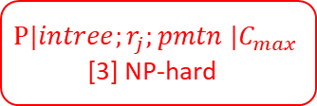



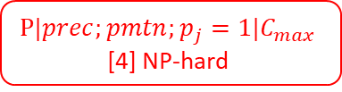
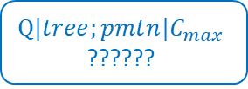
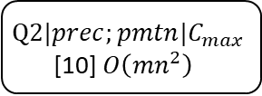
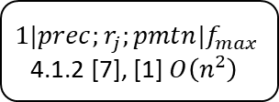
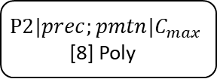

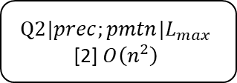
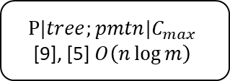
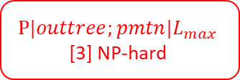



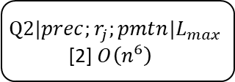

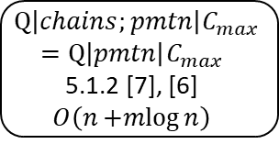
$$1|prec;r_{j};pmtn|f_{max}$$
4.1.2 [7], [1] $O\left(n^{2}\right)$
$$1|prec|f_{max}$$
[12] $O\left(n^{2}\right)$
$$1|prec|L_{max}$$
[13] Poly
$$1|prec;r_{j}|C_{max}$$
[12] $O\left(n^{2}\right)$
$$Q2|prec;r_{j};pmtn|L_{max}$$
[2] $O\left(n^{6}\right)$
$$P|intree;r_{j};pmtn |C_{max}$$
[3] NP-hard
$$1|prec;r_{j};pmtn|L_{max}$$
[11] $O\left(n^{2}\right)$
$$Q2|prec;pmtn|L_{max}$$
[2] $O\left(n^{2}\right)$
$$P|outtree;pmtn|L_{max}$$
[3] NP-hard
Goal
$$Q|prec;pmtn|C_{max}$$
$$1|prec;pmtn|C_{max}$$
$$P2|prec;pmtn|C_{max}$$
[8] Poly
$$Q2|prec;pmtn|C_{max}$$
[10] $O\left({mn}^{2}\right)$
$$P|prec;pmtn;p_{j}=1|C_{max}$$
[4] NP-hard
$$1|tree;pmtn|C_{max}$$
$$P|tree;pmtn|C_{max}$$
[9], [5] $O\left(n\log{m}\right)$
$$Q|tree;pmtn|C_{max}$$
??????
$$Q\left|chains;pmtn\right|C_{max}$$
$$=Q\left|pmtn\right|C_{max}$$
5.1.2 [7], [6] $O\left(n+mlog{n}\right)$
$$P|chains;pmtn|C_{max}$$

Slide 3
References
Baker KR, Lawler EL, Lenstra JK, Rinnooy Kan AH. Preemptive scheduling of a single machine to minimize maximum cost subject to release dates and precedence constraints. Operations Research. 1983 Apr;31(2):381-6.
Lawler EL. Preemptive scheduling of precedence-constrained jobs on parallel machines. Deterministic and stochastic scheduling. 1982 Apr 30;84:101-23. (Only partial access on Google Books)
Lenstra JK. Not Published.
Ullman JD. Complexity of sequencing problems. Computer and Job-Shop Scheduling Theory, EG Co man, Jr.(ed.). 1976. (Unable to find a copy)
Gonzalez TF, Johnson DB. A new algorithm for preemptive scheduling of trees. Journal of the ACM (JACM). 1980 Apr 1;27(2):287-312.
Gonzalez T, Sahni S. Flowshop and jobshop schedules: complexity and approximation. Operations research. 1978 Feb;26(1):36-52.
Brucker P. Scheduling algorithms. Berlin: Springer; 2007 Mar 12.
Muntz RR, Coffman EG. Optimal preemptive scheduling on two-processor systems. IEEE Transactions on Computers. 1969 Nov;100(11):1014-20.
Muntz RR, Coffman Jr EG. Preemptive scheduling of real-time tasks on multiprocessor systems. Journal of the ACM (JACM). 1970 Apr 1;17(2):324-38.
Horvath EC, Lam S, Sethi R. A level algorithm for preemptive scheduling. Journal of the ACM (JACM). 1977 Jan 1;24(1):32-43.
Chetto H, Silly M, Bouchentouf T. Dynamic scheduling of real-time tasks under precedence constraints. Real-Time Systems. 1990 Sep 1;2(3):181-94. (Do not have access)
Lawler EL. Optimal sequencing of a single machine subject to precedence constraints. Management science. 1973 Jan;19(5):544-6.
Lawler EL, Moore JM. A functional equation and its application to resource allocation and sequencing problems. Management Science. 1969 Sep;16(1):77-84.

Slide 4
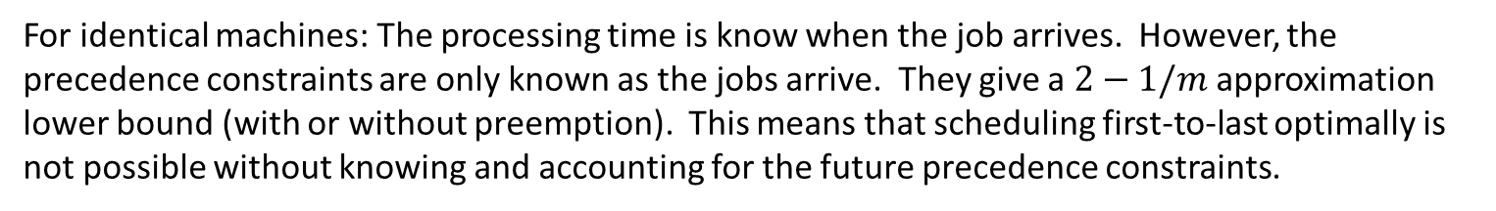

Approximations to
$$Q|prec;pmtn|C_{max}$$
Jaffe JM. An analysis of preemptive multiprocessor job scheduling. Mathematics of Operations Research. 1980 Aug;5(3):415-21.
Jaffe JM. Efficient scheduling of tasks without full use of processor resources. Theoretical Computer Science. 1980 Sep 1;12(1):1-7.
Horvath EC, Lam S, Sethi R. A level algorithm for preemptive scheduling. Journal of the ACM (JACM). 1977 Jan 1;24(1):32-43.
Online Algorithms
Epstein L. A note on on-line scheduling with precedence constraints on identical machines. Information processing letters. 2000 Dec 31;76(4-6):149-53.
Azar Y, Epstein L. On-line scheduling with precedence constraints. Discrete Applied Mathematics. 2002 Jun 15;119(1):169-80.
For identical machines: The processing time is know when the job arrives. However, the precedence constraints are only known as the jobs arrive. They give a $2−1/m$ approximation lower bound (with or without preemption). This means that scheduling first-to-last optimally is not possible without knowing and accounting for the future precedence constraints.

Slide 5
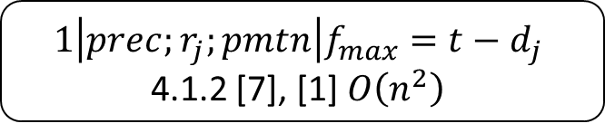
Strategy moving forward
Assume that the task to machine assignment is given.
Now, we only need to schedule the tasks.
For each machine we schedule the tasks using
$$1\left|prec;r_{j};pmtn\right|f_{max}=t−d_{j}$$
4.1.2 [7], [1] $O\left(n^{2}\right)$
And must make sure that $r_{k}=\max_{j}\left\{d_{j}|j→k\right\}$ and that $d_{j}=C_{j}$ in the cost functions.
Does this guarantee (global) optimality?
Are there properties or metrics that can be extracted from the one machine algorithm?

